Slide 1


An introduction to hacking the brain

Slide 2
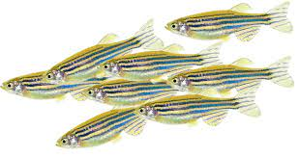
Zebrafish are used in many fields of study
Neuroscience, behavioural neuroscience
Genetic screening
Toxicological screening
Developmental biology
Disease modelling

Slide 3

Which techniques can we used to study the brain?
Need to:
Compare brain areas across species
Identify cell types
Map neural circuits and neurotransmitter systems
Manipulate circuits
Measure behaviour
Quantify data

Slide 4
Gene expression: in situ hybridisation
In situ hybridisation is a technique to visualise gene expression in a tissue
An mRNA probe is made by copying a DNA template – the gene of interest (reverse
transcription)
The mRNA probe is labelled with an antigen (e.g. digoxygenin). It hybridises to the
gene of interest within the tissue
Antibody labelling is used to reveal where the probe binds – fluorescent or
colourimetric detection

Slide 5
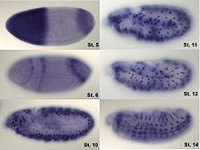
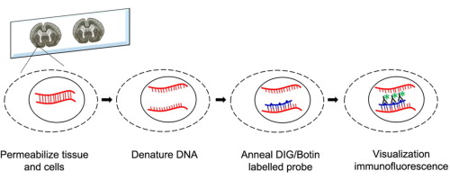
Gene expression: in situ hybridisation
RNA probes that are complementary to the gene of interest are synthesised
Probes are annealed to the tissue and then visualised (whole mount / sections)

Slide 6
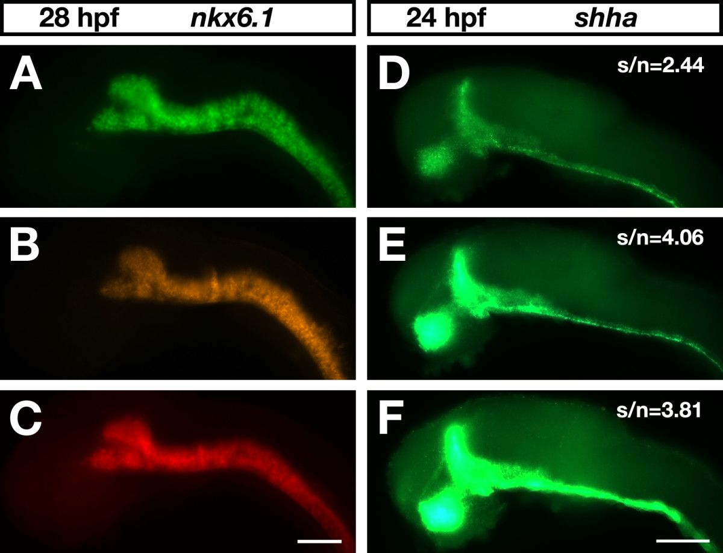
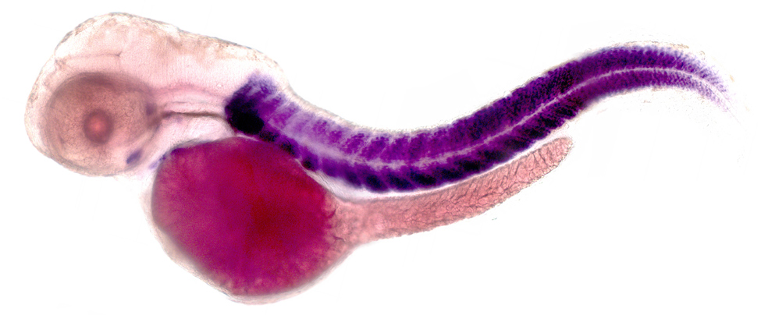
Gene expression: in situ hybridisation
Several genes can be studied using different colours
Lacks cellular resolution; works better for highly expressed genes
Images from Lauter et al., 2011; and UMASS, Amherst

Slide 7
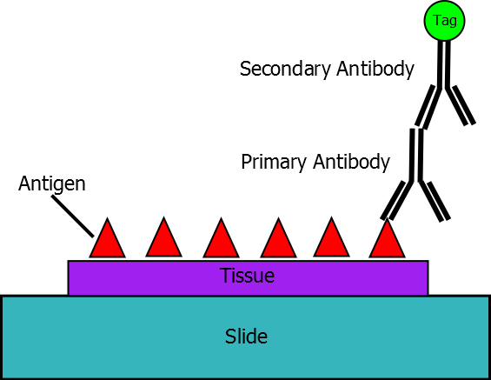
Protein localisation: immunohistochemistry
Antibody labelling can be used to localise proteins in tissues
Primary antibody binds target protein and a secondary antibody is
used to visualise it
Antibodies can be difficult to make; technique is more
expensive than in situ hybridisation
Labelling can give cellular resolution
Image from Wikipedia

Slide 8
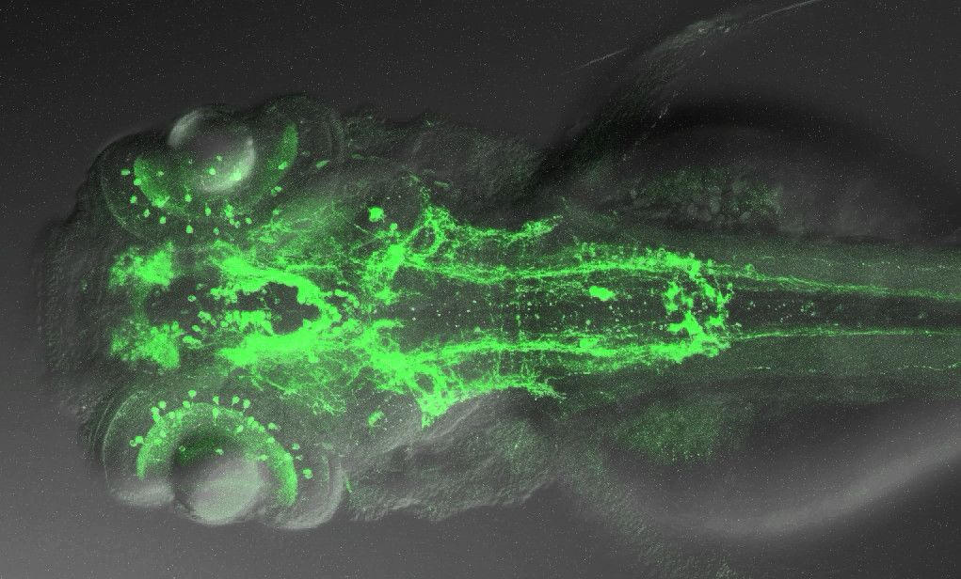
Immunohistochemistry
Zebrafish monoaminergic neurons (image credit: UCL)

Slide 9
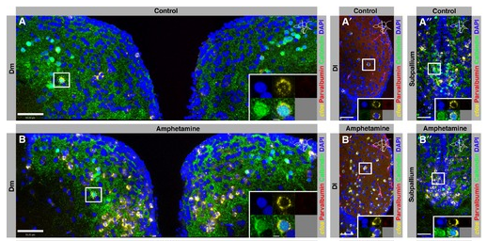
Immunohistochemistry: neural circuit activity
Some proteins are the product of immediate early genes
(e.g. cfos)
IEGs are upregulated by neural activity – can be used to
map the response of the brain to behaviour or drugs
Compare animal with and without
experience of behaviour
No temporal information available
Background noise / specificity?
von Trotha et al., 2014

Slide 10
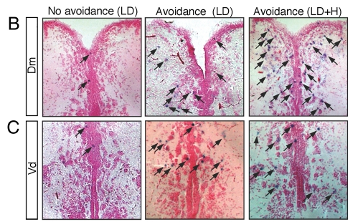
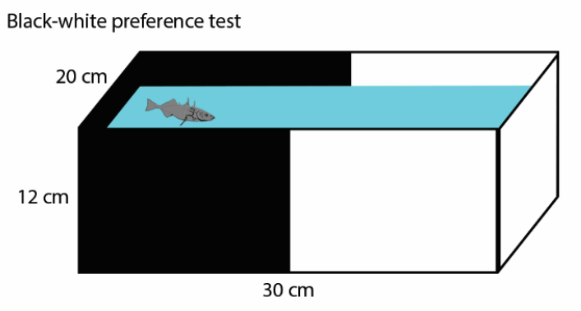
Immunohistochemistry: neural circuit activity
Compare Cfos in the brain of fish that do- or do
not avoid the dark compartment of a tank
Lau et al., 2011

Slide 11
Transgenesis: stable visualisation of proteins
Transgenic lines contain an exogenous DNA sequence – the transgene
Requires appropriate promoter and enhancer elements to be cloned
Various reporters can be used: fluorescent proteins; optogenetic tools; genetic
drivers / amplifiers
Transposable
elements
Transposable
elements
Tissue specific promoter
Transgenic reporter
Stop
signal
Transposons can be used to insert the construct into the genome

Slide 12
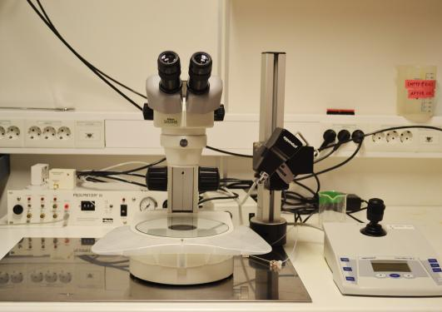
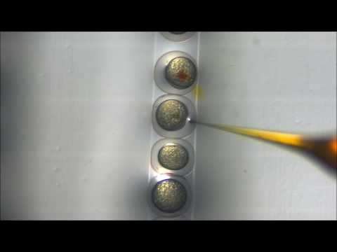
Transgenes can be introduced into animals by microinjection
Needle contains DNA
solution and coloured dye
Animals are grown to the required stage for analysis
Notes:
Constructs can also be feed in some species (RNAi, flies / worms)

Slide 13
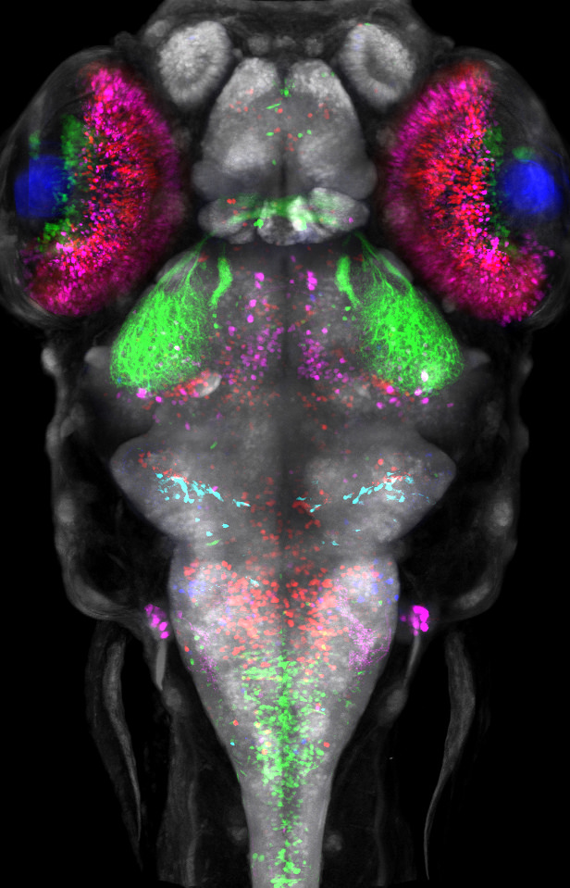
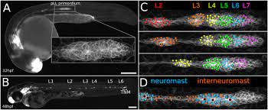
Transgenesis: stable visualisation of proteins
Label multiple cell types at the same time
Movies to show organs growing in real time

Slide 14
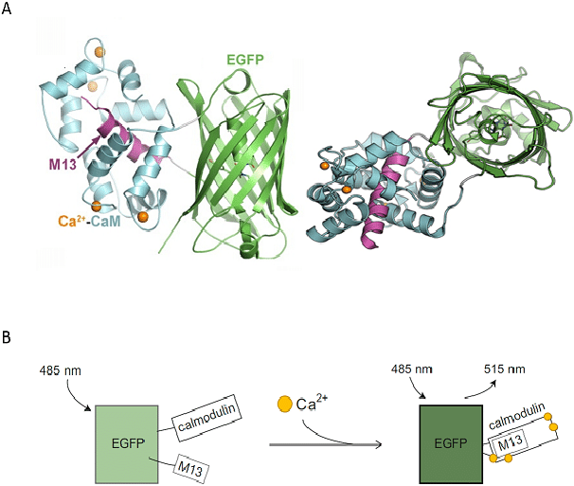
Live imaging with calcium indicators
Genetically-encoded calcium indicators (GECI)
- fluoresce when calcium binds
Since neural activation is Ca dependent,
can be used as a readout of activity

Slide 15
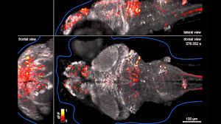
Live imaging with calcium indicators
Genetically-encoded calcium indicators (GECI)
Can be used to visualise neural activity in real time
High resolution – limit is ability of microscope to penetrate tissue
e.g. GCaMP6s

Slide 16
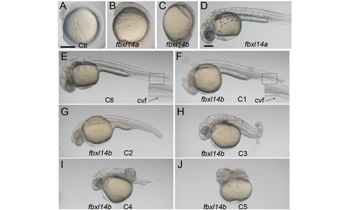
Transgenesis can be used to over-express genes
Gain-of-function experiments in animals
Clone the full length sequence of the
gene of interest under control of a
tissue-specific promoter
Inject into single-cell zebrafish embryos and
grow to grow to required stage
Analyse phenotype
Photo credit: Yiping Li

Slide 17
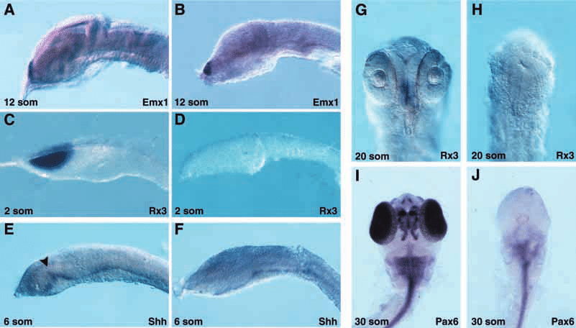
Over-expression can be tissue specific
Overexpression of the engrailed gene reduces zebrafish forebrain development
Ristoratore et al., 1999

Slide 18
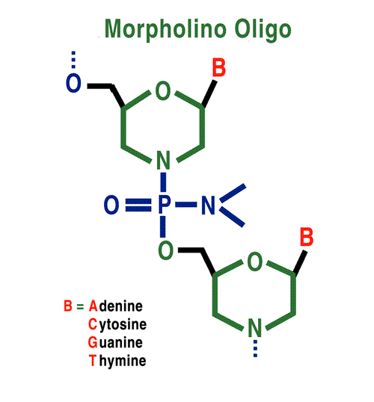
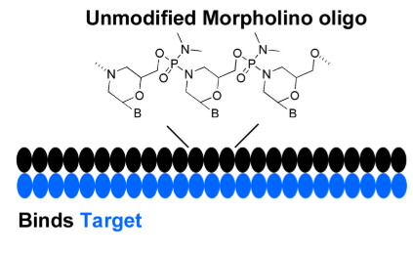
Transient knock-down of genes by microinjection
Morpholino oligonucleotides or anti-sense RNA sequences can be injected to
knock-down gene function
Morpholinos are short antisense oligonucleotides that inhibit translation (no
protein formed). Active for about 5 days before gene function recovers
Notes:
RNAi does not work in all animals

Slide 19
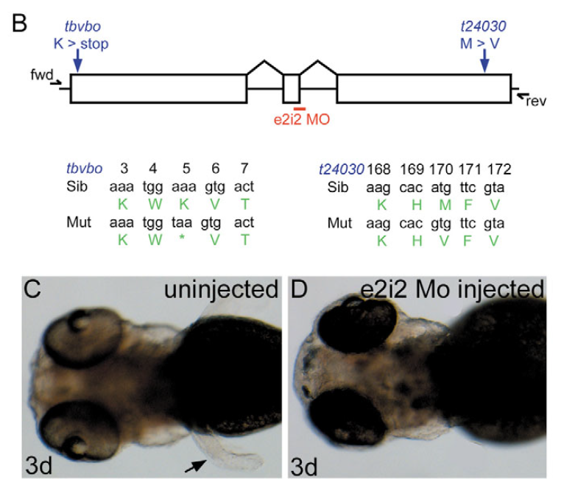
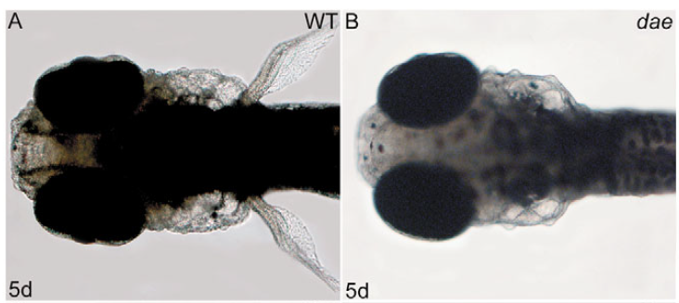
Transient knock-down of genes by morpholino
Morpholinos can be designed to:
Inhibit the initiation codon (ATg)
Inhibit a splice donor or acceptor
fgf10a mutant line
fgf10a splice morpholino injection
Norton et al., 2005

Slide 20
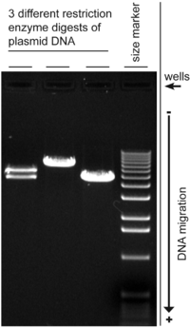
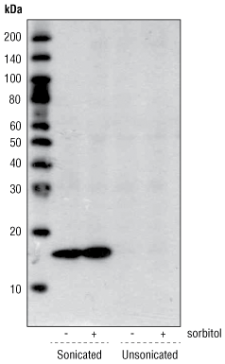
Transient knock-down of genes by morpholino
What about specificity?
Knock-down of genes can be quantified by:
Western blot qPCR
No MO
MO
Look for reduction
of protein levels
Look for changes
to gene splicing

Slide 21

Transient knock-down of genes by morpholino
Morpholinos are: Cheap
Fast to design and inject
Transiently knock-down gene function
Can be non-specific (“off-target effect”)
May cause uncontrolled cell death
Appropriate controls: Design two independent morpholinos
Rescue by co-injecting cDNA
Compare to a stable mutant line

Slide 22
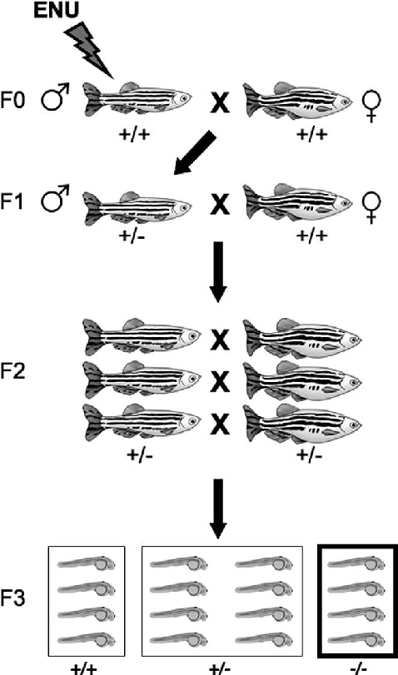
Stable knock-out: chemical mutagenesis
Chemical can be used to mutate genes: e.g.
ethylnitrosourea (ENU)
Random mutagenesis of base-pairs
Can be used to find novel genes important
for a behaviour / process
Lee et al., 2012

Slide 23
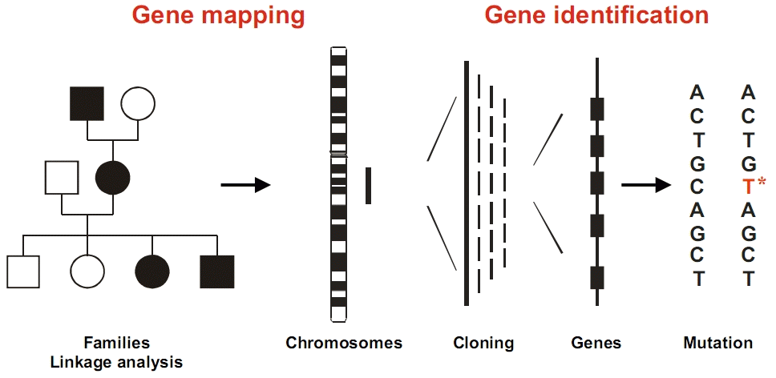
Stable knock-out: chemical mutagenesis
Challenge is to identify the position of the mutation:
Positional cloning
Whole genome sequencing
Linkage can be used to “walk along” the chromosome and identify mutations

Slide 24

Genome engineering
The insertion of deletion of specific sequences in the genome. Targeted – does not rely
on random mutagenesis. Can be used to make stable mutant lines
Techniques include Zinc Finger Nucleases; TALENS (Transcription activator-like effector
nucleases); and CRISPR/Cas9 (clustered regularly interspaced short palindromic repeats)
Ability to mutate nearly any gene (although loci that cannot be mutated do exist)
Notes:
So cannot identify novel genes – limited to our prior knowledge

Slide 25
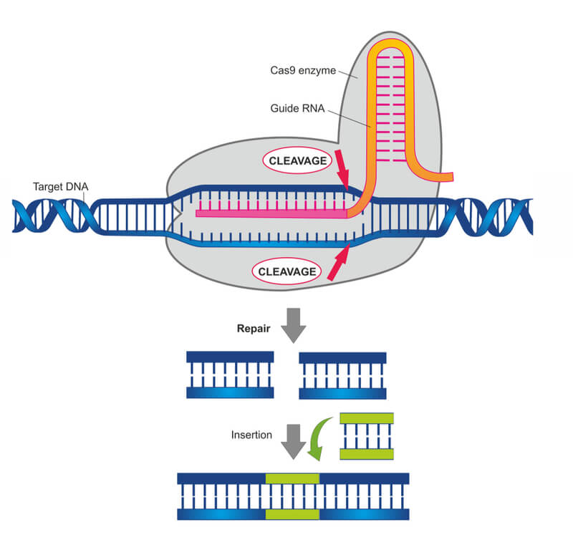
Genome engineering
Design a short guide RNA sequence. Co-inject
with Cas9 protein: Cas9 acts like molecular
scissors to cut the DNA sequence
The body’s natural repair mechanism –
“non-homologous end joining” repairs the cut
In some cases a mistake is made introducing a
mutation
Image from LabBiotech.eu

Slide 26
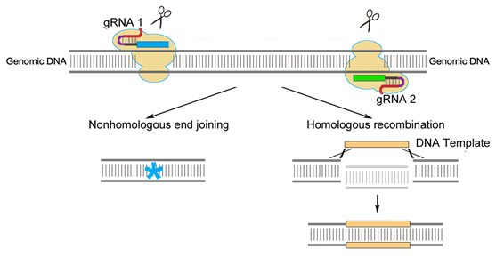
Genome engineering – knock in technology
DNA template with homology arms
Simultaneous inclusion of a novel DNA template can be used to introduce new
sequences: “Homologous Recombination”, “Knock-in”

Slide 27
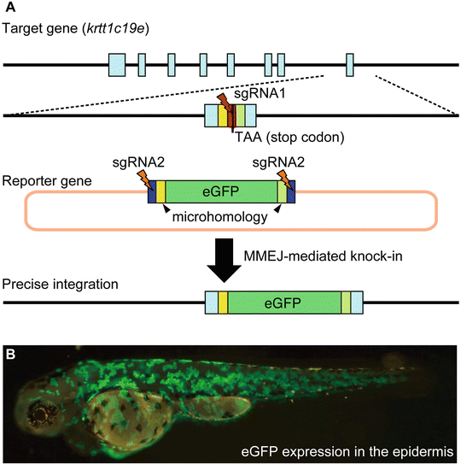
Genome engineering – knocking in genes
Example: knock-in of GPF to
krttc193 locus
Homology arms needed to insert
transgenic cassette
Image from Kawahara, 2017

Slide 28
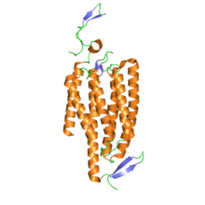
Optogenetics – altering neural activity
Based upon transgenic expression of ion channels that are activated by light:
Channelrhodopsin – activated by blue light. When opened, Ca++ ions
enter neurons (increase firing)
Halorhodopsin – activated by yellow light. When opened, Cl- ions
enter neurons (decrease firing)
Permit temporal and spatial control of neural activity in intact brain
Channelrhodopsin

Slide 29
Summary
Numerous techniques adapted for use in zebrafish, including neuroscience field
Molecular techniques (in situ hybridisation, immunohistochemistry) can be used to
localise neuron types
Immediate early genes to have snapshot of neural circuit activity
Transgenesis to label cells or over-express genes
Knock-out and knock-down techniques established, including CRISPR/Cas9

